Slide 1

Plantastic
Dylan Loers
Lisa Curvers
Marco Jacobs
Nadia Spapens
Tevin Sanzchez

Slide 2
Contents
Recap
Requirement Overview
Evaluation
Future Reccomendations
Demo
Q&A

Slide 3
Recap
Notes:
Pictures to explain what is what

Slide 4
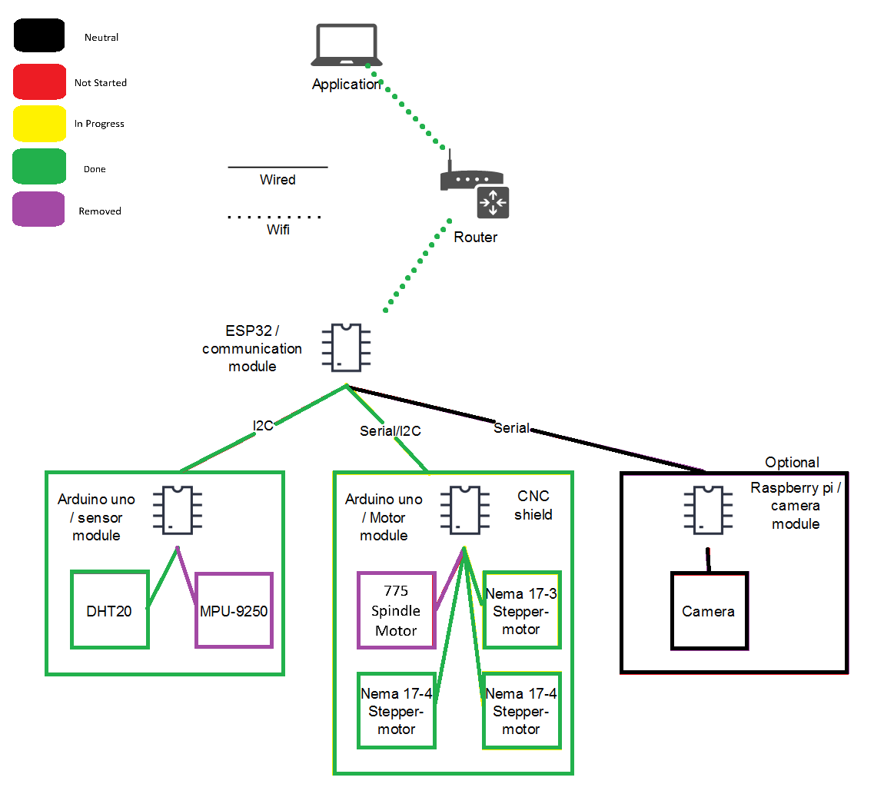
Requirement Overview
ID | Requirement | Status
R_001 | Application | In Progress...
R_002 | Display with Current Info | In Progress...
R_003 | Automatic Emergency Shutdown | In Progress...
R_004 | XYZ Movement Tracking (GUI Drawing) | Pass
R_005 | Emergency Button | In Progress...
R_006 | G-Code Protocol | Pass
R_007 | Temperature Reading | Pass
R_008 | XYZ Movement Tracking (Accelerometer) | N/A
R_009 | Multiple Bits | N/A
R_010 | Camera Feed | N/A
R_011 | Self-Retrieving Finished Product | N/A
R_12 | Self-Inserting Material | N/A

Slide 5
Evaluation
Process
Technical
What went well
Dividing tasks (end)
Documentation
Communication
Collaboration
What went wrong
Dividing tasks (beginning)
Git
What went well
Fast progress
Integration stepper protocol
What went wrong
Late parts delivery
Notes:
On process and technical aspect, what went well/wrong?

Slide 6
Future Reccomendations

Slide 7
Demo

Slide 8
Q&A

